Slide 1
Introduction to 3D Graphics Programming with Direct3D and .NET
Ben Houston
Neuralsoft Corporation

Slide 2
Slight Topic Change
Direct3D specific, OpenGL is rather difficult to use from C#.
3D graphics programming focus, 2D is a subset of 3D.

Slide 3
Rendering is Simulation
The idea is to (usually) simulate how a virtual world with artificial properties would appear if it existed in real-life.
Components of reality:
  Observer – our eyes, a camera, etc…
  Light sources – radiate light energy (i.e. photons)
  Physical entities that reflect, absorb, and filter the light energy.
Two main approaches:
  Global illumuniation / global simulation
  Local illumination / local simulation

Slide 4
Global Illumination
Models light from source, to its possibly many interactions in the environment (reflection, refraction, diffusion, absorption) and how it is percieved by the observer.
Common approaches:
  Ray tracing (doesn’t handle diffusion well)
  Radiosity (doesn’t handle reflection well, very slow)
  Photon mapping (very nice results)

Slide 5

Global Illumination – Photon Mapping
high detail models, depth of field, soft shadows, reflective surfaces.

Slide 6

Global Illumination – Photon Mapping
refraction, reflection
index of refraction varies with light wavelength creating rainbow effects.
+ 30 minutes render time per frame.

Slide 7
Local Illumination
Each surface is shaded sequentially based local information only, no general global information is provided.
Any global illumination effects are “faked” via various shortcut methods.
The current generation of GPUs is restricted to local illumination models – for now...

Slide 8
History of 3D Graphics on the PC
Castle Wolfenstien (1992)
Descent (1994)
Descent II (1995)
Lara Croft & Quake (1996)
…. faster and faster …
Doom 3 & Half-Life 2 (2004)

Slide 9
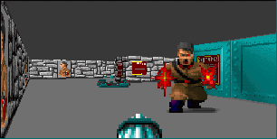
Castle Wolfenstien (1992)
The first popular 3D first person shooter.
Was a 2D ray caster combined with vertical scan line rasterization.
Written by John Carmark (who later created the Doom, and Quake series.)

Slide 10
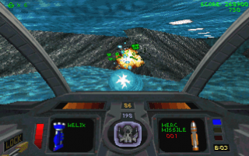
Descent and Descent II (1994-95)
One of the first popular true 3D textured polygon-based game.
Used highly optimized software routines – ran at 320x200 and had very obvious “jitters.”
One of the first games to supported 3D graphics accelerators.
  ATI & Matrox offered slow acceleration – often slower than software.
  3DFX Voodoo Graphics chipset was amazing.

Slide 11
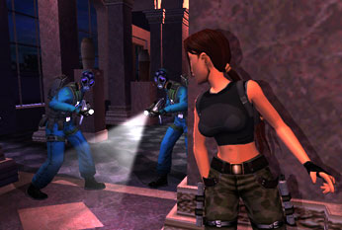
Lara Croft & Quake (1996)
The first 2 major 3D textured polygon-based first person shooters.
3D graphics accelerators became popular
The fact that Quake used OpenGL as its 3D API almost single handedly kept Direct3D out of the spotlight for a couple years.

Slide 12
… faster and faster …
3D was everywhere, almost it almost always used the fixed-function rendering pipeline.
Multi-pass rendering was used to create complex effects.
NVIDIA GForce 2 (~2000) introduced the programmable pipeline
  Programs had to be written in assembler.
  Had to be less than 256 instructions.
  No loops.
  Was mostly ignored.

Slide 13
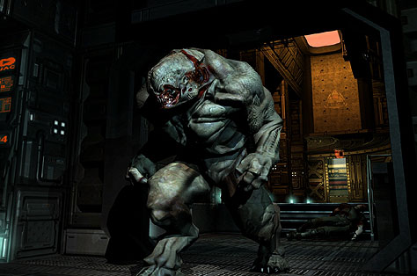
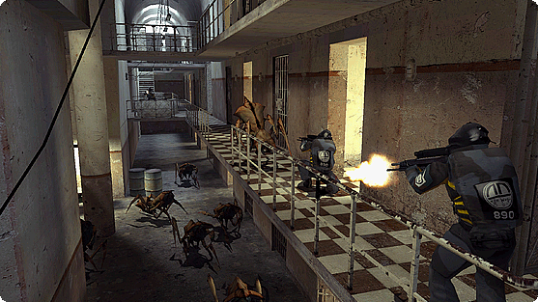
Doom III & Half-Life 2 (2004)
New GPUs along with Cg/HLSL make the programmable pipeline usable.
Absolutely beautiful effects.

Slide 14
Getting Started – Managed DirectX
DirectX: “An advanced suite of multimedia application programming interfaces (APIs) built into Microsoft Windows® operating systems”
Fully featured managed layer for the DirectX runtime.
  Fits within the style guidelines for .NET
  Does everything you can do with native DirectX
Managed Direct X Characteristics / Features:
  High Performance
  Interoperates with native C++ DirectX
  Design Stresses ease of use.
  Event model.
  Strongly types functionality.
  Structured exception handling.

Slide 15
Getting Started - MyForm
// contains useful algebra structs: Matrix, Vector3, Plane, Quaternion
using Microsoft.DirectX;
// contains everything else: Device, Mesh, Texture, Light, Material, …
using Microsoft.DirectX.Direct3D;
public class MyForm : System.Windows.Forms.Form {
  public MyForm() {
    this.InitializeComponent(); // initialize WinForms controls (optional)
    this.InitializeGraphics(); // initialize Direct3D stuff
    // this.InitializeVertexBuffer(); // initialize vertices (2nd example)
    }
  …

Slide 16
Getting Started – Device Setup
Device _device = null;
public void InitializeGraphics() {
  PresentParameters presentParams = new PresentParameters();
  presentParams.Windowed = true; // we are not in full screen mode
  presentParams.SwapEffect = SwapEffect.Discard;
  // create our drawing surface and specify full GPU acceleration…
  _device = new Device(0, DeviceType.Hardware, this, CreateFlags.HardwareVertexProcessing, presentParams);
}

Slide 17
Getting Started - Rendering
protected void Render() {
// clear the frame buffer prior to rendering
_device.Clear( ClearFlags.Target, Color.Black, 1.0f, 0 );
_device.BeginScene(); // always paired with _device.EndScene()
this.DrawScene();
_device.EndScene();
_device.Present(); // show this frame buffer on screen
}
protected void DrawScene() {
// doing nothing for the moment
}

Slide 18
Getting Started - Main
static void Main() {
using( MyForm myForm = new MyForm() ) {
myForm.Show();
// render and process messages until quit
while( myForm.Created ) {
myForm.Render();
Application.DoEvents();
}
}
}

Slide 19
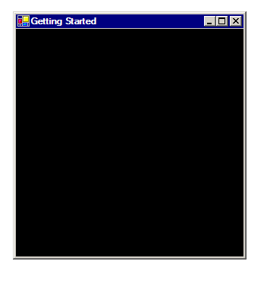
Getting Started – Example

Slide 20
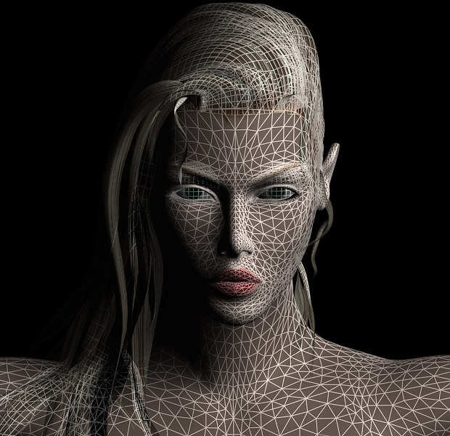
Simple 2D – Introduction
*Everything* rendered is composed of vertices and triangles.
You can use a lot of tiny polygons giving the impression of curved surfaces.
Multiple layers of semi-transparent polygons can create smoke or fire effects.

Slide 21
Simple 2D – Screen Vertices
using TCVertex = CustomVertex.TransformedColored; // simply our code
public void InitializeVertexBuffer() {
// specify the corner locations and colors of our first triangle
TCVertex[] verts = new TCVertex[3];
verts[0] = new TCVertex( new Vector4( 150, 50, 1, 1 ), Color.Red.ToArgb() );
verts[1] = new TCVertex( new Vector4( 250, 250, 1, 1 ), Color.Green.ToArgb() );
verts[2] = new TCVertex( new Vector4( 50, 250, 1, 1 ), Color.Yellow.ToArgb() );
…
X
(150,50)
Positions of TransformedColored vertices are
specified in Screen Space
(50,250)
(250,250)
Y
Notes:
typeVertexType System.Type . Member of the Type enumerated type that indicates the type of vertex data the buffer holds. This can be a value type or any type that contains only value types.numVerts System.Int32 . Maximum number of vertices the buffer can hold.device Microsoft.DirectX.Direct3D.Device . The Device object to associate with the vertex buffer.usage Microsoft.DirectX.Direct3D.Usage . Usage can be 0, which indicates no usage value. However, if usage is desired, use a combination of one or more Usage flags. It is good practice to match the usage parameter in the VertexBuffer constructor with the behavior flags in the Device constructor. See Remarks.vertexFormat Microsoft.DirectX.Direct3D.VertexFormats . Combination of VertexFormats flags that describe the vertex format of the vertices in the buffer.pool Microsoft.DirectX.Direct3D.Pool . Member of the Pool enumerated type that describes a valid memory class in which to place the resource.

Slide 22
Simple 2D - Rendering
// vertex buffers hide the complexity of loading vertices into GPU memory
_vertexBuffer = new VertexBuffer( typeof( TCVertex ), verts.Length, _device, 0, TCVertex.Format, Pool.Default );
GraphicsStream graphicsStream = _vertexBuffer.Lock( 0, 0, LockFlags.None );
graphicsStream.Write( verts );
_vertexBuffer.Unlock();
}
protected void DrawScene() {
_device.SetStreamSource( 0, _vertexBuffer, 0 );
_device.VertexFormat = TCVertex.Format;
_device.DrawPrimitives( PrimitiveType.TriangleList, 0, 1);
}

Slide 23
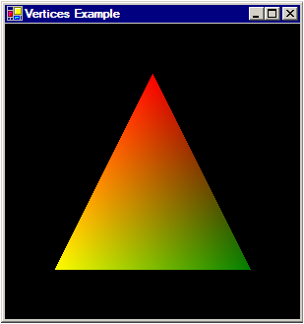
Simple 2D - Example

Slide 24
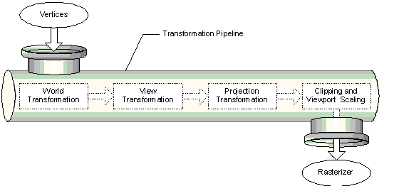
Simple 3D - Introduction
The Transformation Pipeline:
converts 3D vertices into 2D screen coordinates

Slide 25
Simple 3D – World Vertices
using PCVertex = CustomVertex.PositionColored;
public void InitializeVertexBuffer() {
// specify the corner locations and colors of our first triangle
PCVertex[] verts = new PCVertex[3];
verts[0] = new PCVertex( new Vector3( 0, 1, 0 ), Color.Red.ToArgb() );
verts[1] = new PCVertex( new Vector3( 1, -1, 0 ), Color.Green.ToArgb() );
verts[2] = new PCVertex( new Vector3(-1, -1, 0 ), Color.Yellow.ToArgb() );
…
Y
(0,1)
Positions of PositionColored vertices are
specified in World Space
X
(-1,-1)
(1,-1)

Slide 26
Simple 3D – Matrix Math
Transforms are Vector-Matrix multiplications.
Matrices are 4x4 homogeneous matrices.
The affine transforms:
  Scale
  Rotations
  translation
The projection transforms:
  Perspective
  Orthogonal

Slide 27
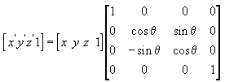
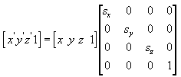
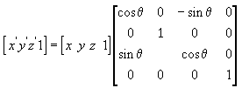
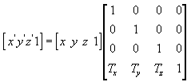
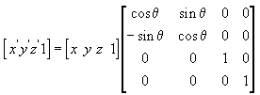
Simple 3D – Affine Transforms
Rotations
Scaling
X-Axis
Y-Axis
Translation
Z-Axis

Slide 28
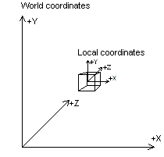
Simple 3D – Affine Transforms
protected void DrawScene() {
// ensure rotation speed is independent of computer speed
float rotationAngle = ( 2*Math.PI ) *
((Environment.TickCount % 1000) / 1000f);
_device.Transform.World = Matrix.RotationY( rotationAngle );
…

Slide 29
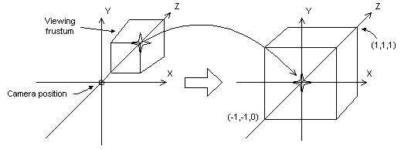
Simple 3D – Affine Transforms
Camera can be placed and oriented arbitrarily within world space.
…
_device.Transform.View = Matrix.LookAtLH(
new Vector3( 0, 0, -5 ), // target location
new Vector3( 0, 0, 0 ), // eye/camera location
new Vector3( 0, 1, 0 ) ); // “up” axis
…
Y
Side
View
Z
Camera
(0,0,-5)

Slide 30
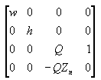
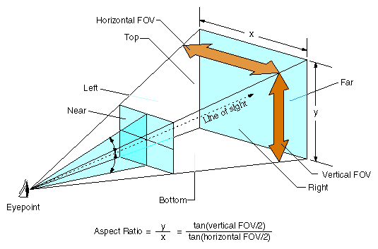
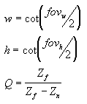
Simple 3D – Perspective Transform
…
_device.Transform.Projection = Matrix.PerspectiveFovLH(
(float) Math.PI / 4, // y-axis field of view
1, // pixel aspect ratio
1, // near z clipping
100 ); // far z clipping
…

Slide 31
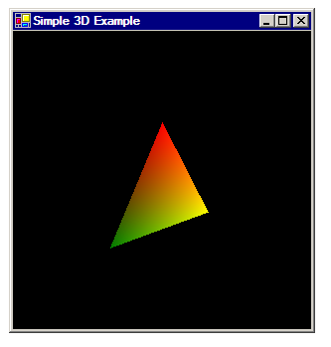
Simple 3D - Example

Slide 32
Simple Shading – Introduction
Three illumination components can be specified:
  Ambient – solid shading
  Diffuse – general contour shading
  Specular – shine, highlight
Three shading models:
  Flat –one color per triangle, calculated at midpoint.
  Gouraud – one color per vertex, color interpolated across triangle interior
  Phong – one color per pixel, parameters interpolated across triangle interior
Requires Materials & Lights.

Slide 33
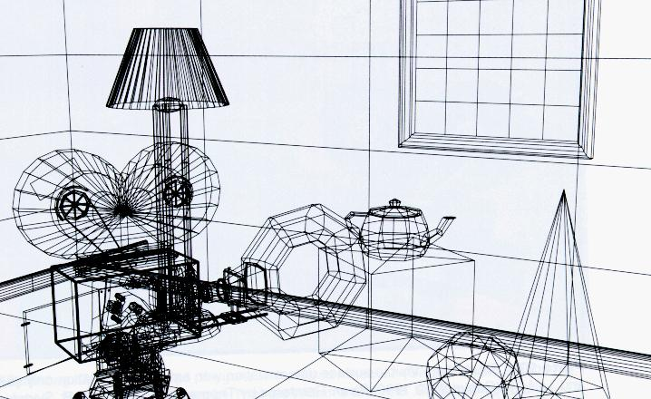
Simple Shading – Wireframe

Slide 34
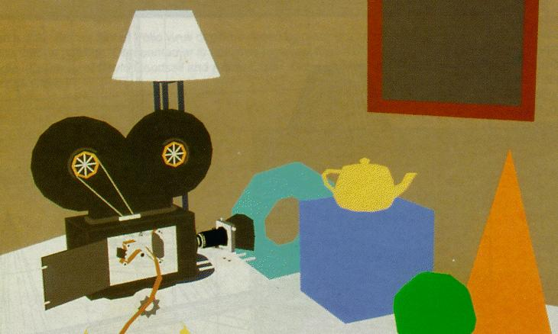
Simple Shading – Flat / Ambient

Slide 35
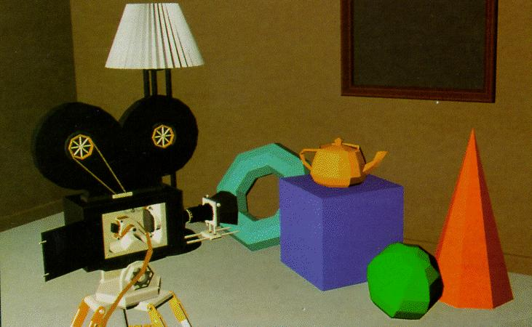
Simple Shading – Flat / Amb. + Diff.

Slide 36
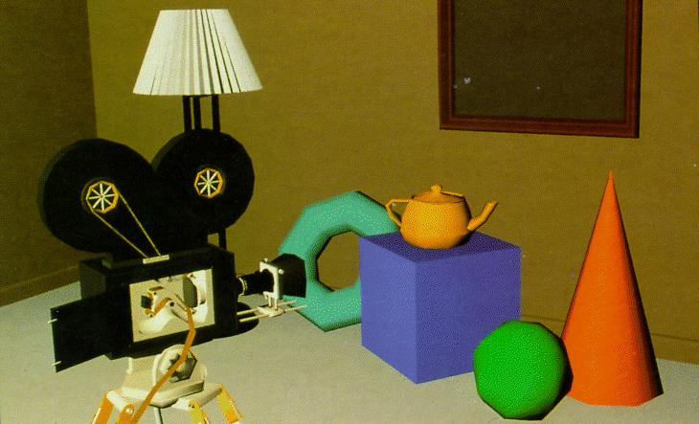
Simple Shading – Gouraud / Amb. + Diff.

Slide 37
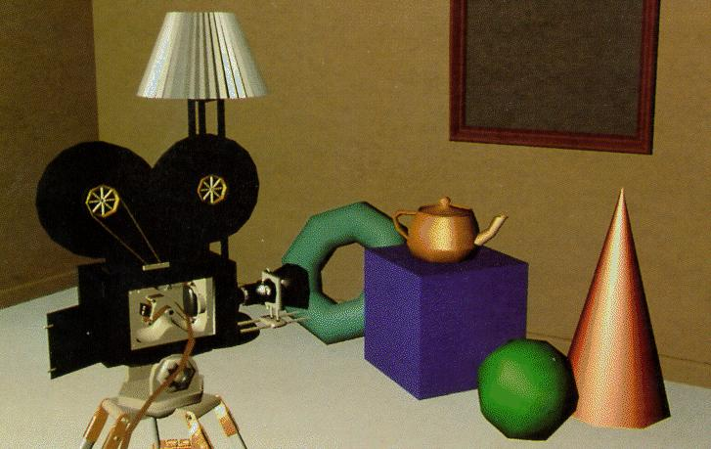
Simple Shading – Gouraud / Amb. + Diff. + Spec.

Slide 38
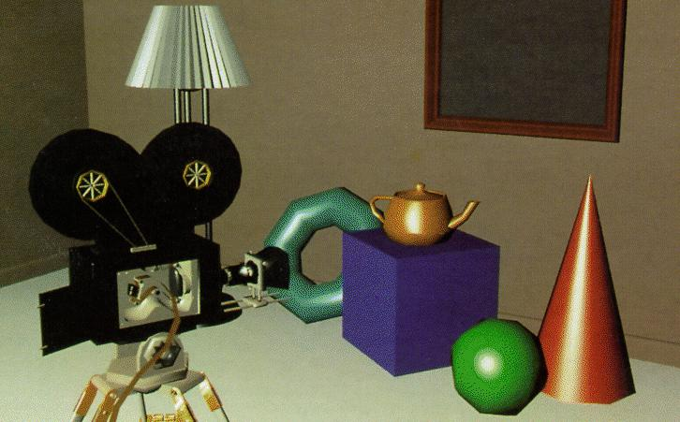
Simple Shading – Phong / Amb. + Diff. + Spec.

Slide 39
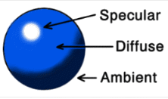
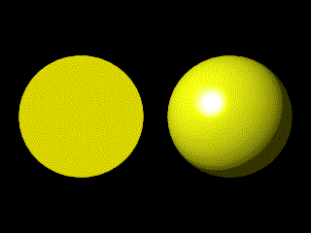
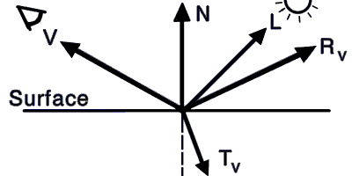
Simple Shading – Phong
Calculate at each pixel of the triangle.
Uses the interpolated surface normal, incoming light direction and the viewer direction to compute the specular, diffuse components.

Slide 40
Simple Shading – Vertex Normals
using PNVertex = CustomVertex.PositionNormal;
public void InitializeVertexBuffer() {
// specify the corner locations and colors of our first triangle
PNVertex[] verts = new PNVertex[3];
verts[0] = new PNVertex( new Vector3( 0, 1, 0 ), new Vector3( 0, 0, 1 ) );
verts[1] = new PNVertex( new Vector3( 1, -1, 0 ), new Vector3( 0, 0, 1 ) );
verts[2] = new PNVertex( new Vector3( -1, -1, 0 ), new Vector3( 0, 0, 1 ) );
Y
Y
Front
View
(0,1)
Side
View
Z=1
X
Z
(-1,-1)
(1,-1)
Z=-1

Slide 41
Simple Shading – Materials & Lights
protected void DrawScene() {
// create simple blue material
Material material = new Material();
material.Diffuse = Color.Blue;
_device.Material = material;
// create light pointing at triangle, aligned with view
_device.Lights[0].Type = LightType.Directional;
_device.Lights[0].Direction = new Vector3( 0, 0, 1 );
_device.Lights[0].Enabled = true; // turn it on
_device.RenderState.Lighting = true;
…
Y
Side
View
Light Direction
Z

Slide 42
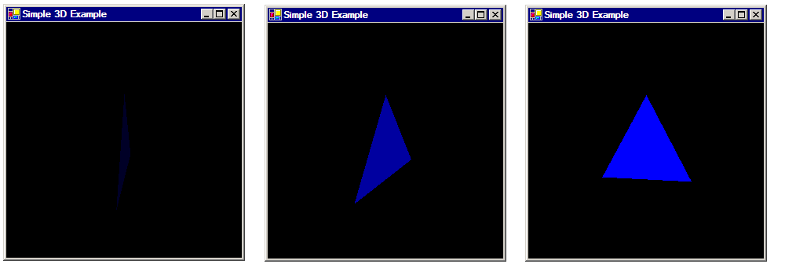
Simple Shading - Example

Slide 43
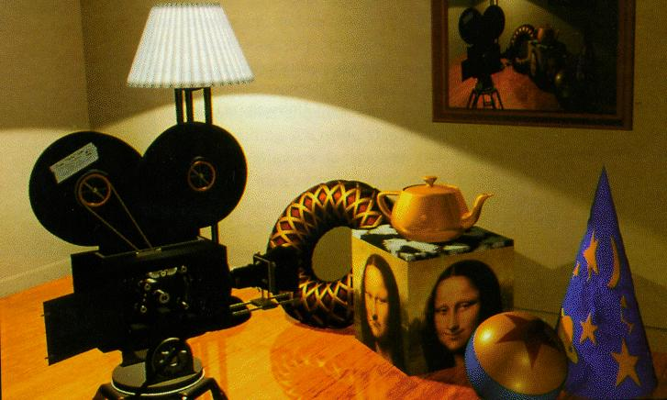
Simple Textures - Introduction
It is computationally more efficient to represent small details via textures (colors, bump maps, normal maps, etc.) than via adding more triangles.

Slide 44
Simple Textures - Setup
public void InitializeVertexBuffer() {
_texture = TextureLoader.FromFile( _device, “texture.png” ); // load our bitmap
// specify the corner locations and colors and texture coords of our first triangle
PNTVertex[] verts = new PNTVertex[3];
verts[0] = new PNTVertex( new Vector3( 0, 1, 0 ), new Vector3( 0, 0, 1 ), 0.5f, 0 );
verts[1] = new PNTVertex( new Vector3( 1, -1, 0 ), new Vector3( 0, 0, 1 ), 0, 1 );
verts[2] = new PNTVertex( new Vector3( -1, -1, 0 ), new Vector3( 0, 0, 1 ), 1, 1 );
…
}
protected void DrawScene() {
_device.SetTexture( 0, _texture ); // specify texture to use
_device.TextureState[0].ColorOperation = TextureOperation.Modulate;
_device.TextureState[0].ColorArgument1 = TextureArgument.TextureColor;
_device.TextureState[0].ColorArgument2 = TextureArgument.Diffuse;
_device.TextureState[0].AlphaOperation = TextureOperation.Disable;
…

Slide 45
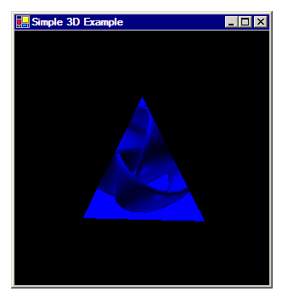
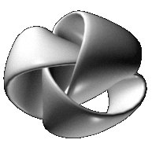
Simple Textures - Example
The bitmap used as a texture

Slide 46
More Direct3D Topics
Meshes
Complex Pixel Shaders
Shadow Maps
Deforming Meshes via Vertex Shaders
Precomputed Lighting (including: Radiance Transfer)
Visibility Culling Algorithms: Z Buffer, BSP-trees, Portals
Fonts
Render to Texture
Progressive Meshes

Slide 47
Game Programming
It’s a lot more than just graphics these days:
Player: input, rendering, world navigation.
Non-player characters: AI, animation.
World: physics simulation, on-demand loading of mesh & textures, massive databases for MORPGs.
Biggest challenge: synchronizing complex worlds across multiple computers linked via the unreliable internet.

Slide 48
Game Programming – Issues
The bad news you need to know:
  Writing a Game is hard
  Writing a Great Game is really, really hard (and takes a LOT of money these days)
  Game Programmers make LESS money than business programmers
  And there’s fewer openings (1 game programming job per every 1000 “real” programming jobs)
  ..and the industry has a bad “Deathmarch” reputation
The good news
  Writing Games is fun and rewarding (usually)
  You job will always be “cooler” than other jobs
  Writing games and tools in Managed DirectX is MUCH easier than standard DirectX
(information from David Weller’s managed DirectX presentation)

Slide 49
Game Programming – Skills
Math
2D and 3D Graphics Techniques
Math
Physics
Math
Computer Science skills: data structures, algorithms, networking, large scale design, etc.
Math
(information from David Weller’s managed DirectX presentation)

Slide 50
Business Graphics / Visualization
Create a scene graph (instead of a functional approach)
  Simplifies: representation, layout, manipulation and hit testing.
  Bonus: make scene graph independent of Direct3D, thus allowing you to use it for 2D cases with GDI+.
Avalon, the replacement for GDI+ in Longhorn, is just a supped up scene graph.

Slide 51
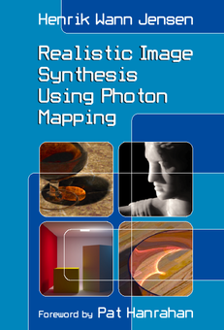
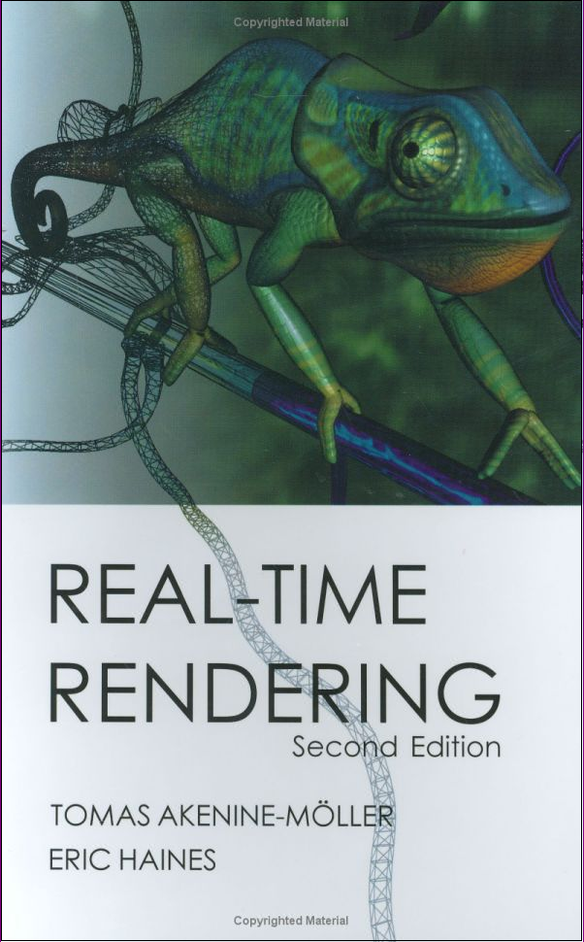

Further Reading – General Books

Slide 52
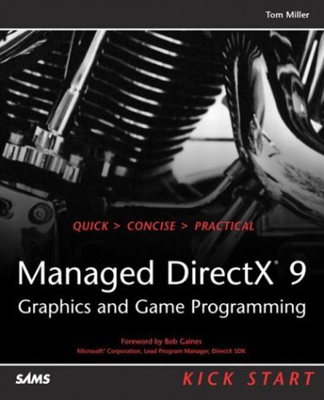
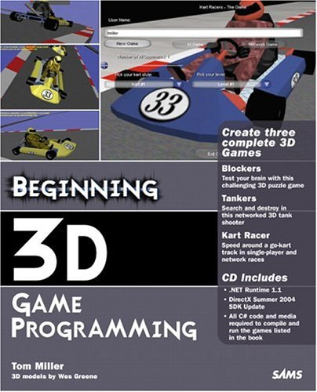

Further Reading - DirectX Books
(information from David Weller’s managed DirectX presentation)

Slide 53
Further Reading - Web Resources
General
International Game Developers Assoc. - www.igda.org
GamaSutra - www.gamasutra.com
Game Developer - www.gamedev.net
Direct X
MSDN - www.msdn.com/directx
Newsgroup - microsoft.public.win32.programmer.directx.managed
The Z Buffer - www.thezbuffer.com
Tom Miller (main coder/designer) - blogs.msdn.com/tmiller
David Weller (?) - blogs.msdn.com/dweller
(information from David Weller’s managed DirectX presentation)

Slide 54
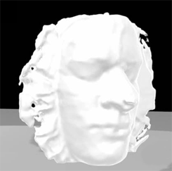
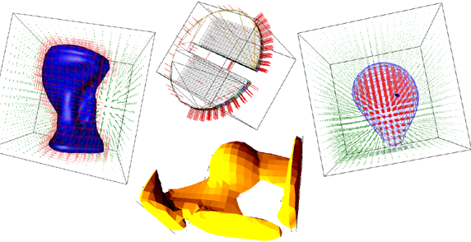
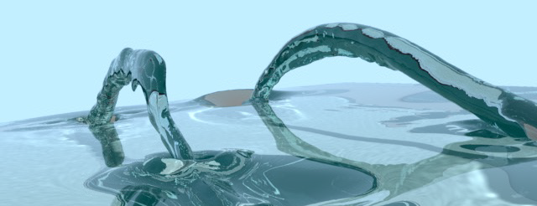
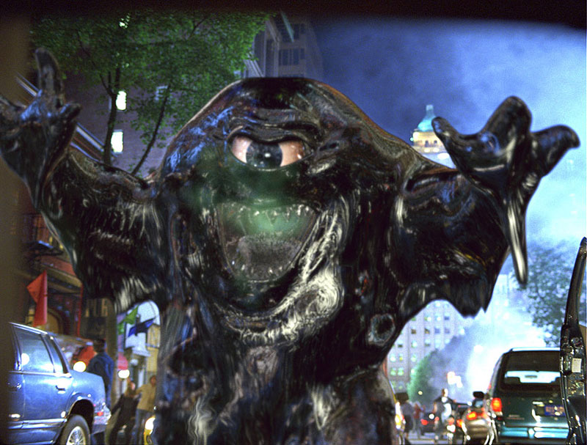
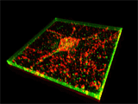
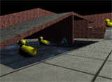
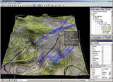
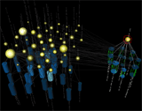
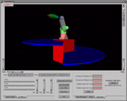
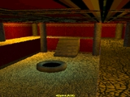

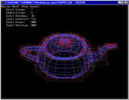
That’s It
Ben’s personal contact information:
Website: www.exocortex.org (lots of C# and 3D code)
Email: ben@exocortex.org

